Slide 1
House Price in the U.S.
Hok Yin Cheung

Slide 2
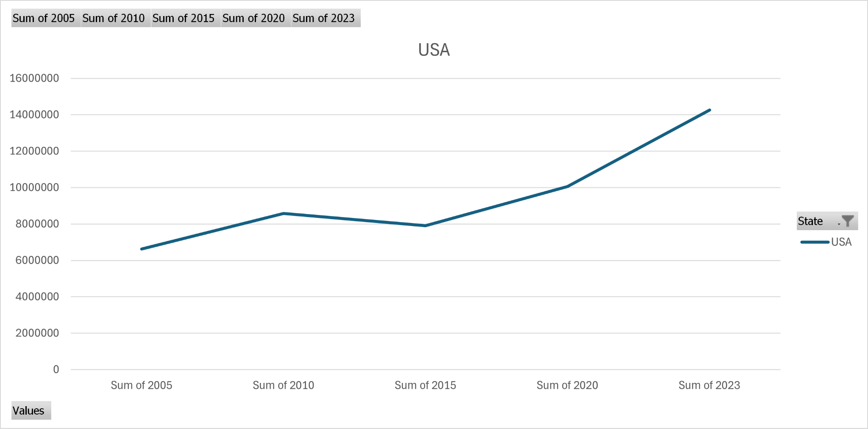

Slide 3
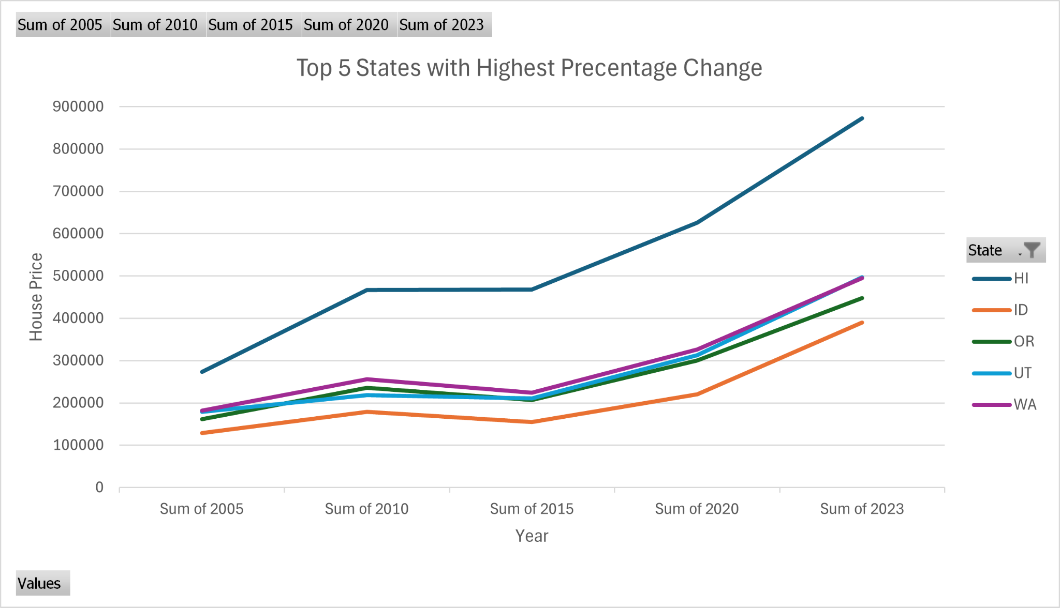
Top 5 States with Highest Change

Slide 4
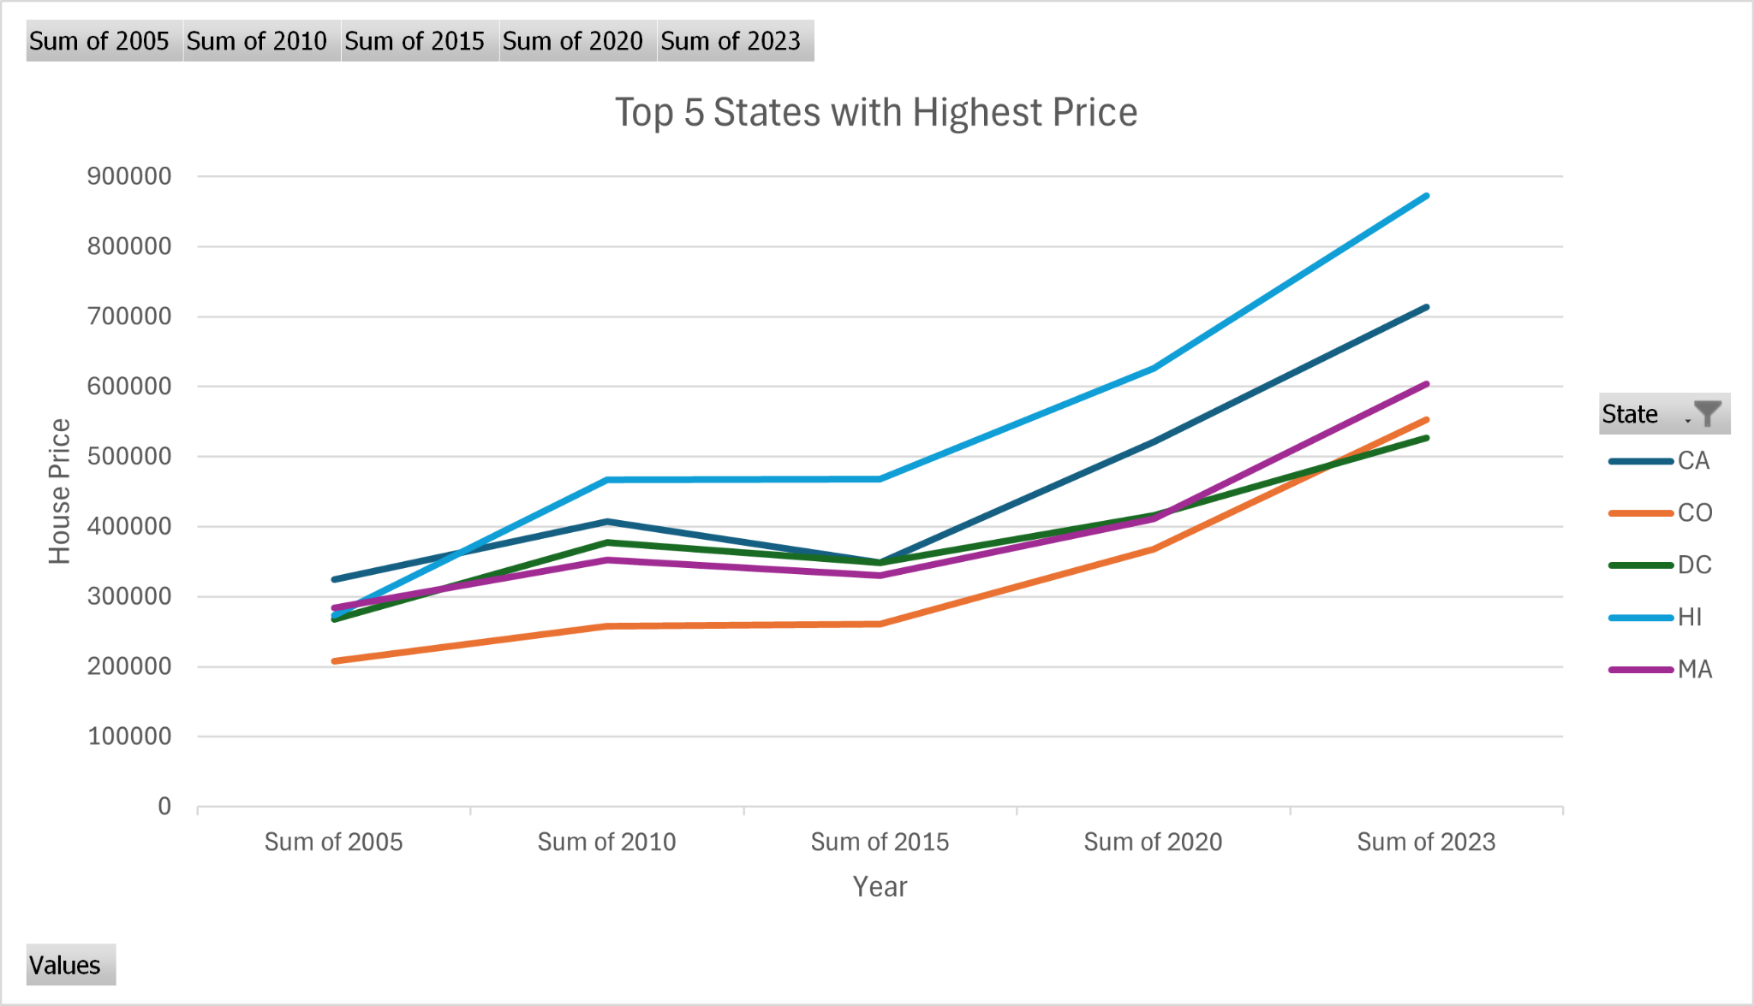
Top 5 States with Highest Price

Slide 5
Summary
The overall house prices from 2005 to 2023 have been rising. There was a small dip between 2010 and 2015, but after 2015, house prices skyrocketed.
The top 5 states with the highest overall percentage change are Hawaii, Idaho, Utah, Oregon, and Washington.
The top 5 states with the highest house prices in the U.S. are Hawaii, California, Colorado, Massachusetts, and the District of Columbia.

Slide 6
Thank you!

